Slide 1




Harmonizing Asynchronous Systems: NATS, CloudEvents, and AsyncAPI
Notes:
Welcome everyone!
Today, I want to talk about how we can ”harmonize” Asynchronous Systems. As humans we use metaphors and abstraction to cope with complexity and I thought I would use the Just In Time delivery metaphor from Supply Chain Management to help us see how we can use NATS, CloudEvents, and AsyncAPI to create robust, scalable solutions.

Slide 2
Hello!
I am Artur Ciocanu.
I am here today to talk about NATS, CloudEvents and AsyncAPI. Twitter/X: @artur_ciocanu LinkedIn: https://www.linkedin.com/in/artur-ciocanu/
GitHub: @artur-ciocanu
Notes:
Hello my name is Artur, I am Lead Senior Computer Scientist currently working at Adobe. You can find my on the Internet using these handles.

Slide 3

Contents
Introduction
NATS
CloudEvents
AsyncAPI
Demo
Conclusion
Notes:
Here is a quick rundown of the things we will cover today. We will have a quick introduction, then we will briefly cover each technology, and I hope to have time for a quick demo.

Slide 4

Introduction

Slide 5

Notes:
Asynchronous systems are like highways during rush hour—there’s a lot of traffic, and things need to keep moving. But unlike our real-world traffic, we can design these highways to be super-efficient!

Slide 6

Introduction
Harmony
Harmonizing
A state where different elements come together seamlessly, creating a sense of peace and unity
Blending different parts to create a cohesive and pleasing whole
Notes:
The title of the talk mentions “harmonizing”, so I think it is important to understand the definition of “harmony” and “harmonizing”. I really like the piece with “cohesive and pleasing whole”.
As engineers we forget that if something is pleasing most probably it will also be easier to understand.

Slide 7

Notes:
As I mentioned in the beginning, we will be using Just In Time delivery from Supply Chain Management.
This picture tries to depict how boxed good are moved around in a very efficient and predictable way.

Slide 8



Introduction
NATS
CloudEvents
AsyncAPI
Notes:
In Supply Chain Management we have a lot of concepts, but for the sake of simplicity I decided to focus on:
Transportation – where NATS is the star of the show
Packaging – here we have CloudEvents
AsyncAPI – it serves as a map or a route planner, providing the optimal route from point A to point B

Slide 9
NATS

Slide 10


Slide 11
NATS
NATS – connectivity fabric
Low latency and high performance.
Supports multiple messaging patterns (e.g., pub/sub, request/reply, work queue, streaming, etc).
Highly available with built-in resilience.
CNCF Incubating Project.
Notes:
NATS is an old project it was initially released in 2011. It was later rewritten from Ruby to Go and later became a CNCF project.
NATS might be known as a messaging system, but it is much more than that. It is like a Connectivity Fabric, that can be used across your enterprise to connect both internal and external systems.
If you haven’t seen Derek Collison presentation called “Rethink Connectivity” I highly recommend it. Derek is NATS creator.
For our Just In Time delivery metaphor, you can think of NATS both as the roads and the fleet of trucks, trains or airplanes.

Slide 12
CloudEvents

Slide 13


Slide 14
CloudEvents
CloudEvents – message packaging
Lightweight, essential metadata.
Enhances interoperability between systems.
Supports various event-driven architectures.
Protocol agnostic
CNCF Graduated Project.
Notes:
CloudEvents is a very tiny specifications that has been build in collaboration with major tech companies including Amazon, Microsoft, Google, Adobe, etc.
Its focus is to provide essential metadata for any intermediary to be able to act, validate, transform or route. By design it doesn’t have all the bells and whistles, that you could find in other specifications. Anyone remember the good old days of various XML specifications ☺.
For the Just In Time delivery metaphor, you can think of CloudEvents as the standard sized boxes or containers that have labels and routing details, but we don’t necessarily know what is inside those boxes.

Slide 15


Slide 16
CloudEvents
Just Enough Metadata
specversion – CloudEvents specification version.
id – identifies the event.
source – identifies the context in which the event happened.
type – describes the type of the event.
Notes:
I like to think of CloudEvents as J. E. M. – Just Enough Metadata, the reason I am mentioning this is that we as engineers tend to add more and more to a specification, we always see use cases and things we can add.
But in engineering just like in cooking or art, we should find a balance and use “just enough”.
CloudEvents spec is starting to add other things like discovery, etc and I am not sure if this the right move.

Slide 17
AsyncAPI

Slide 18


Slide 19
AsyncAPI
AsyncAPI – routes descriptions
Defines how messages are sent and received.
Ensures consistency across services.
Provides clear documentation for developers.
Provides various tooling for docs, code gen, etc
Joined Linux Foundation in 2021
Notes:
OpenAPI is probably the well known by the majority and it is used to describe REST APIs aka RPCs. AsyncAPI the other hand is not new by any stretch but is not well known.
AsyncAPI has an ambitious goal to be able to describe both RPC style APIs as well Event Driven API.
For our Just In Time delivery metaphor AsyncAPI is like a map or a route planner, that describes how packaged boxes or containers should go from source to destination, and it can contain detailed information about what is stored in the boxes and how the content of the boxes should be handled.

Slide 20
Demo Setup
Notes:
Now that we are done with the theoretical part, let’s see all these technologies in action.

Slide 21
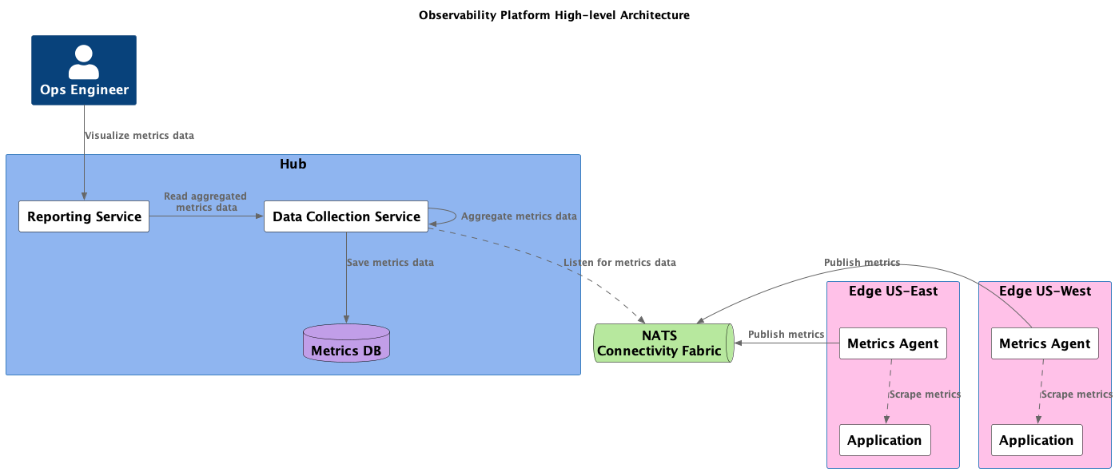
Notes:
This is a very simplified version of a fictional observability platform. The purpose of this is to demonstrate the usage of NATS, CloudEvents and AsyncAPI.
Usually, people are defaulting to eCommerce examples, I decided to use Observability Platform as an example.
At a high level we have:
NATS – which acts a nervous system connecting all the pieces
Metrics Agents – that are collecting metrics data
Data Collection Service – responsible for data transformation, aggregation, etc
Reporting Service – responsible for presenting the aggregated metrics
Now, let’s see it in action. We’re going to simulate an observability platform. Watch as our agents send data, workers process it, and we visualize the results—all using NATS, CloudEvents, and AsyncAPI.

Slide 22
Conclusion

Slide 23
Conclusion
Key Takeaways
NATS – transport, the nervous system.
CloudEvents - the perfect packaging with a little bit of JEM.
AsyncAPI – the route planner for a smooth delivery
Notes:
As we wrap up, remember the key players in your system:
NATS - the transport mechanism, the nervous system of a solution,
CloudEvents - the packaging, JEM
AsyncAPI - the route planner.
Together, they harmonize to create a resilient, efficient, and scalable system.

Slide 24


Slide 25
THANK YOU !
Notes:
Thank you! I hope you enjoyed our journey! Now, let’s dive into your questions. Feel free to ask anything about how these tools work or how you can start using them in your projects.

Slide 26
Resources
https://nats.io/
https://www.asyncapi.com/en
https://modelina.org/
https://cloudevents.io/
https://github.com/artur-ciocanu/presentations/tree/main/apidays-conf-london-2024/code
Notes:
Here are some of the resources. All the code from the demo you can find in my GitHub repo. Feel free to check it out and open issues if you have any questions.

